Slide 1
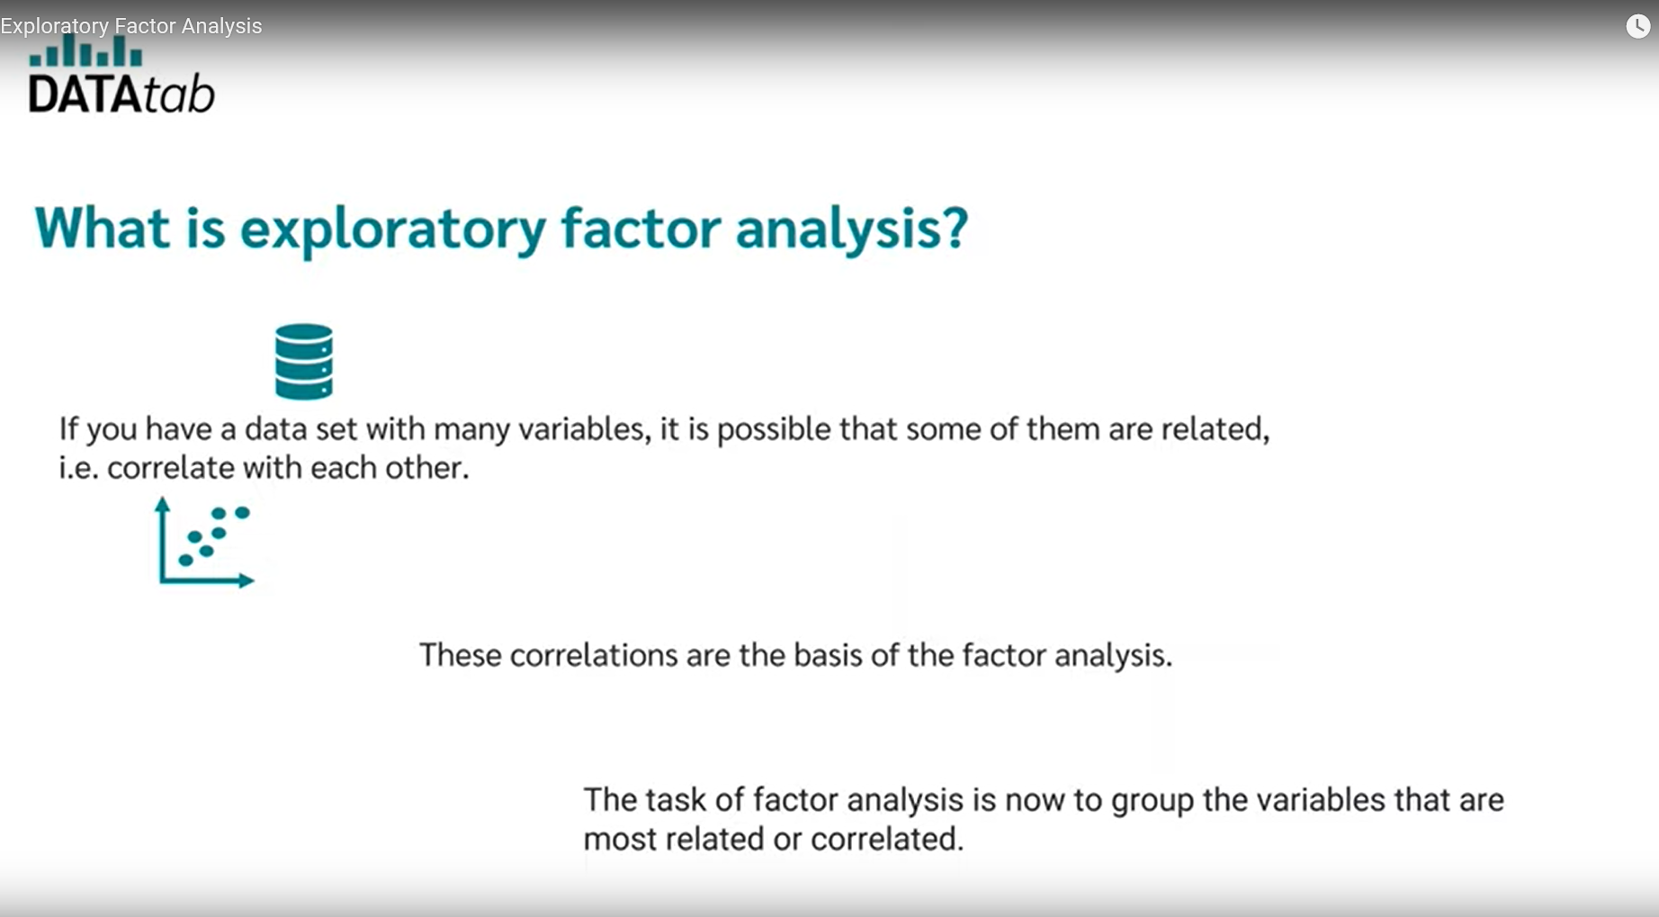

Slide 2
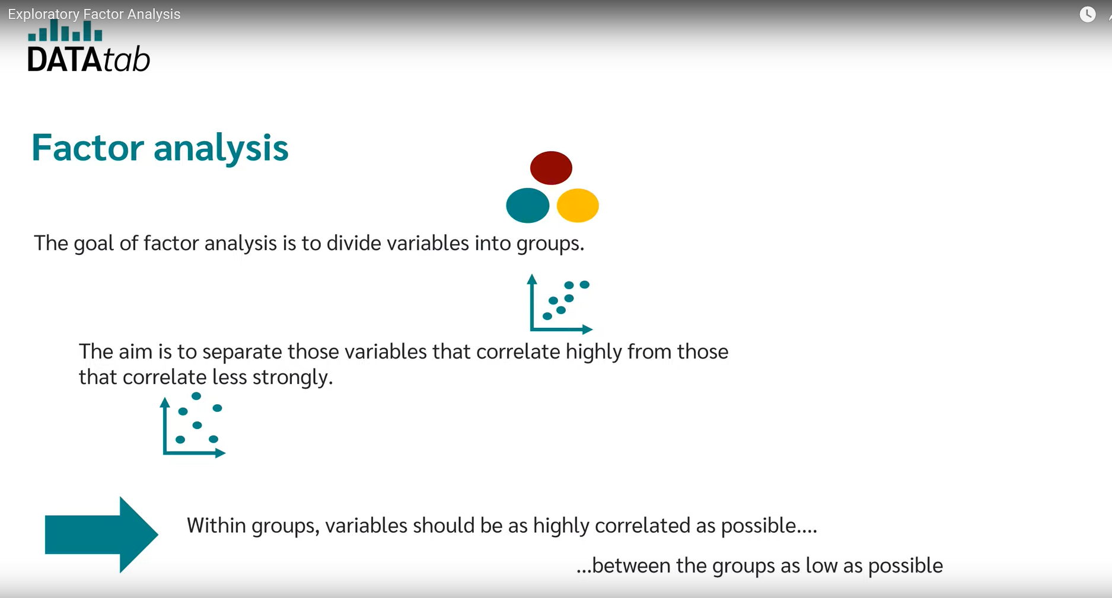

Slide 3
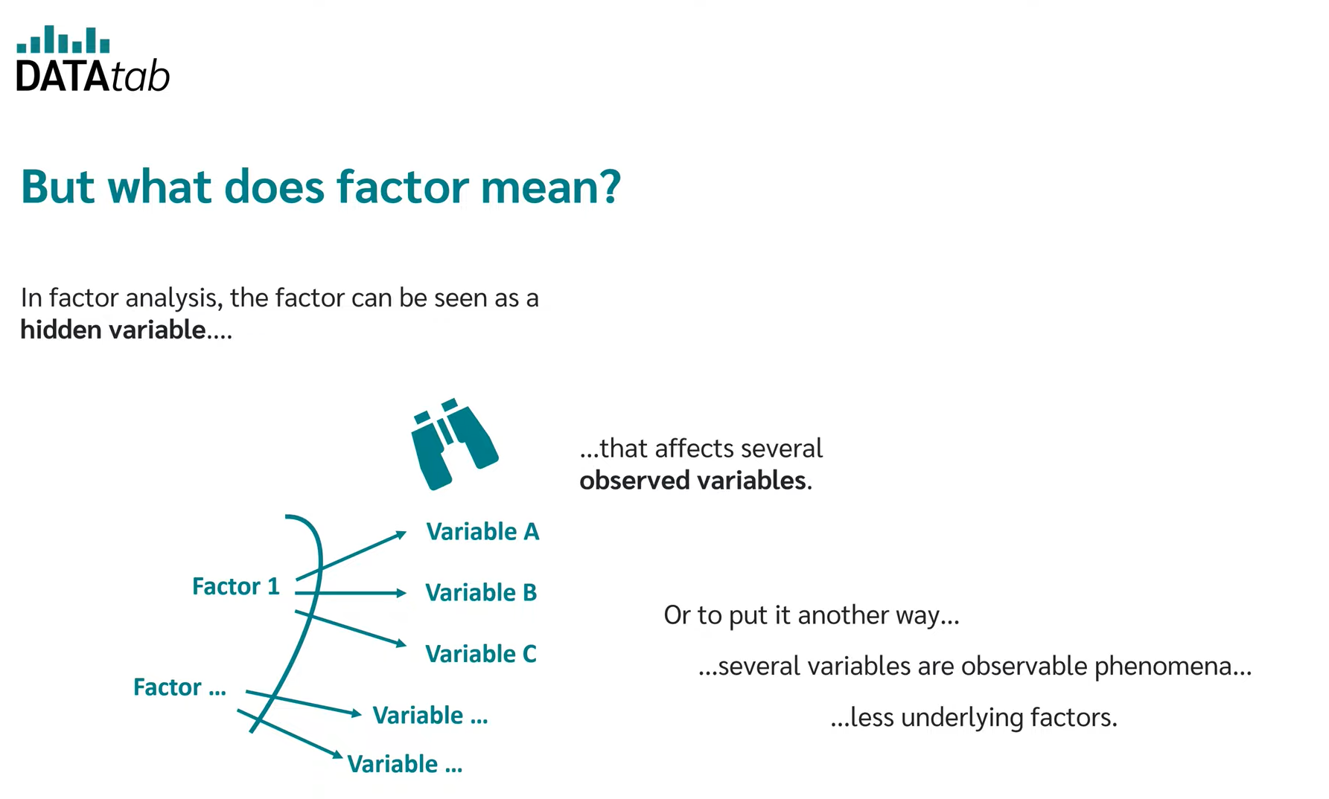

Slide 4
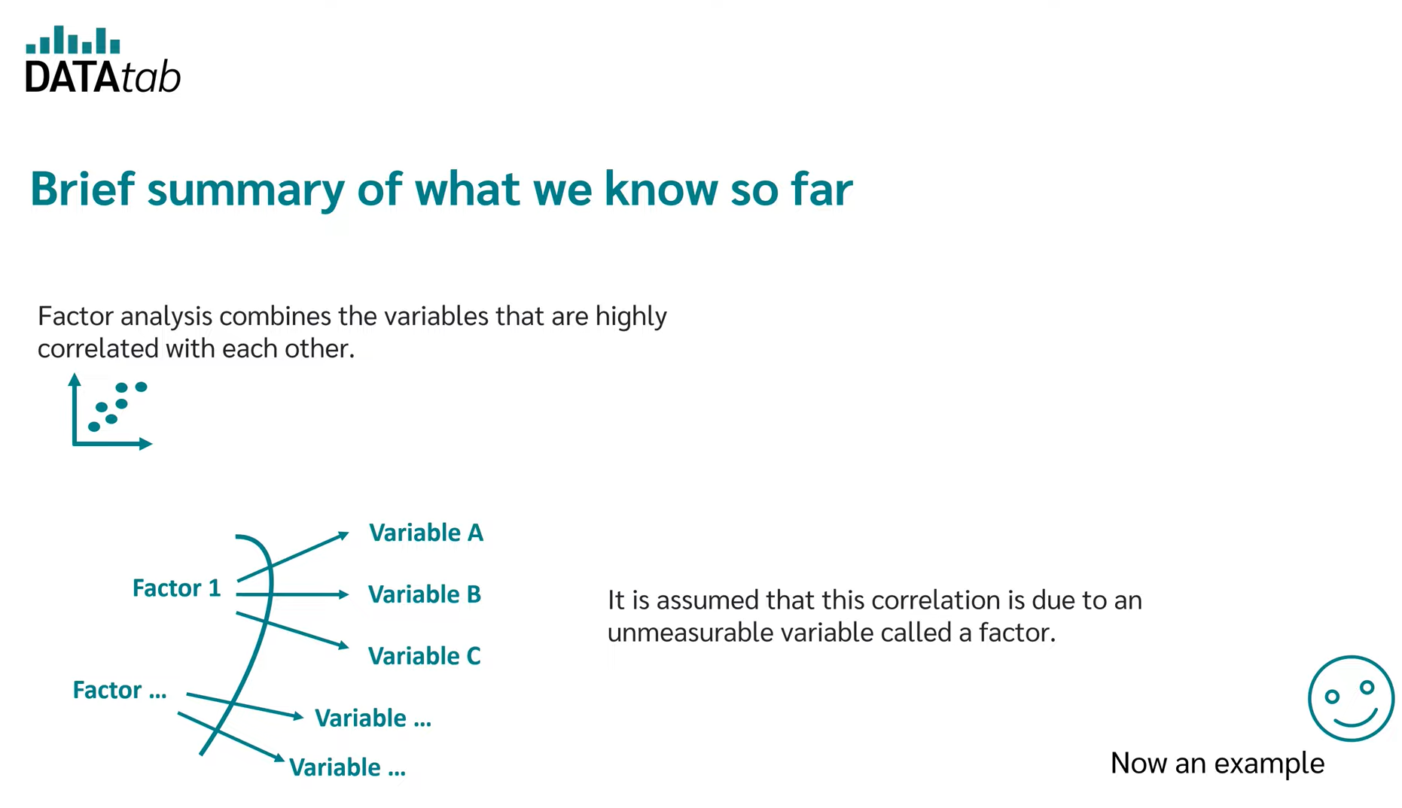

Slide 5
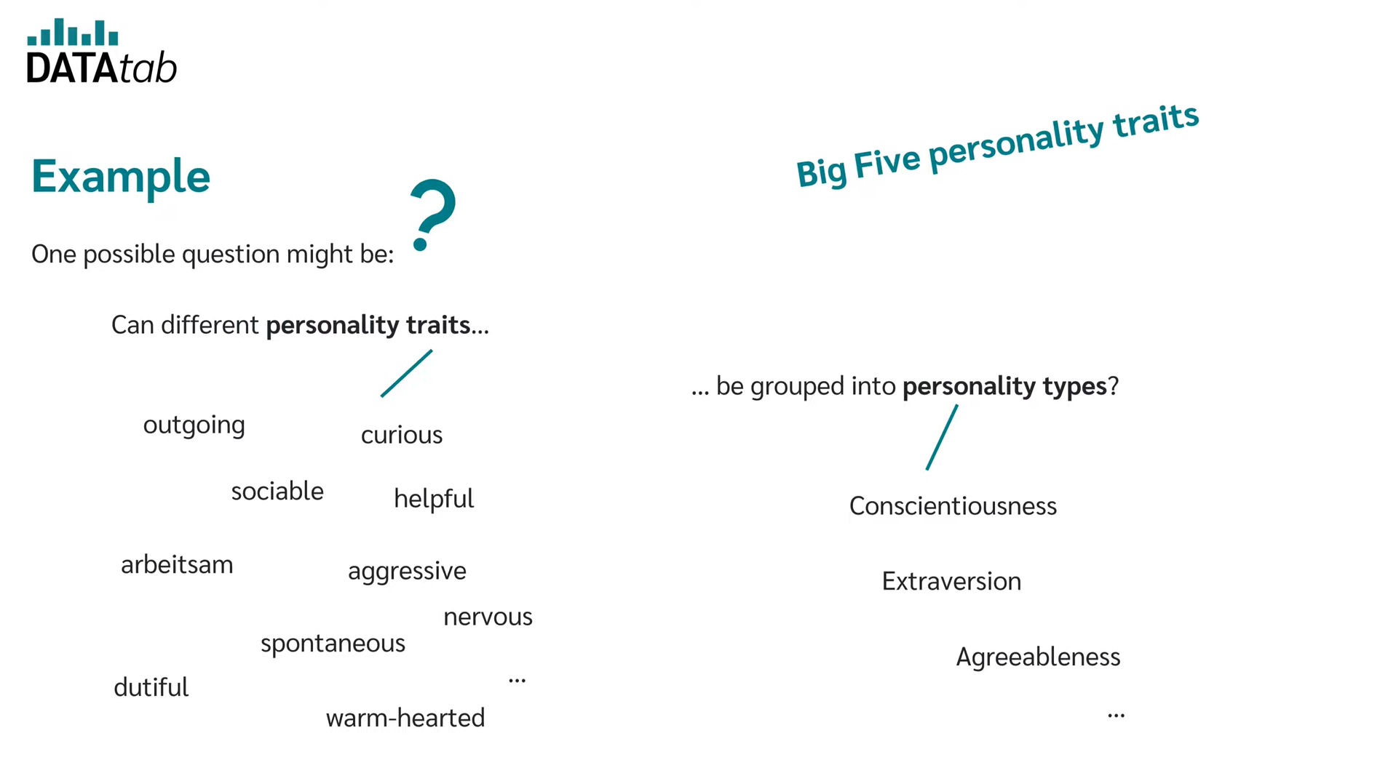

Slide 6
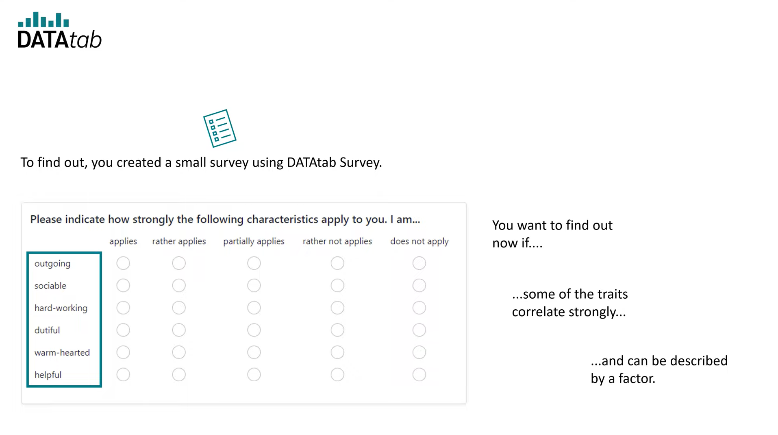

Slide 7
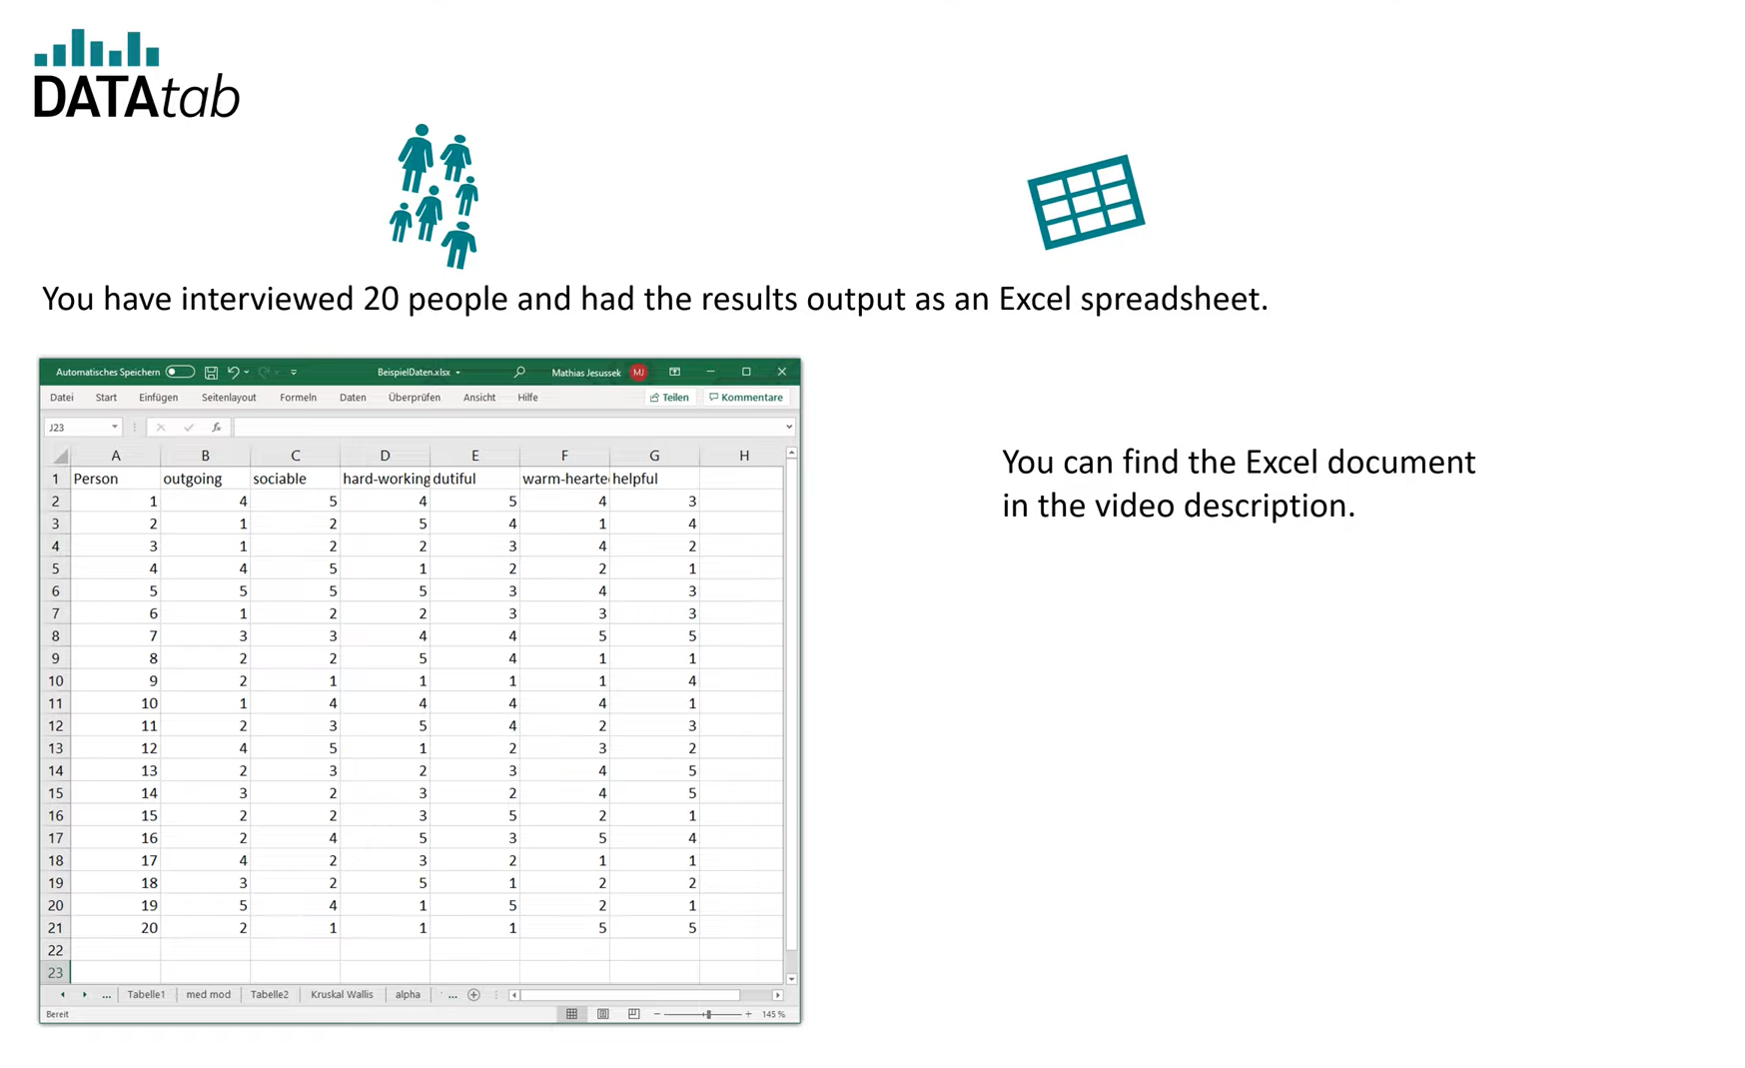
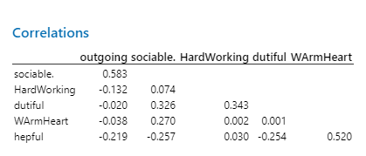
Minitab Output

Slide 8
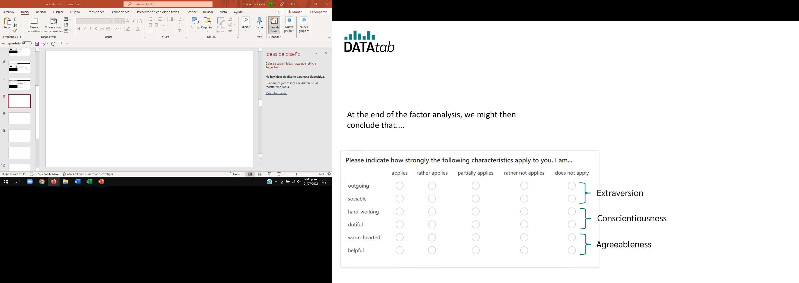

Slide 9
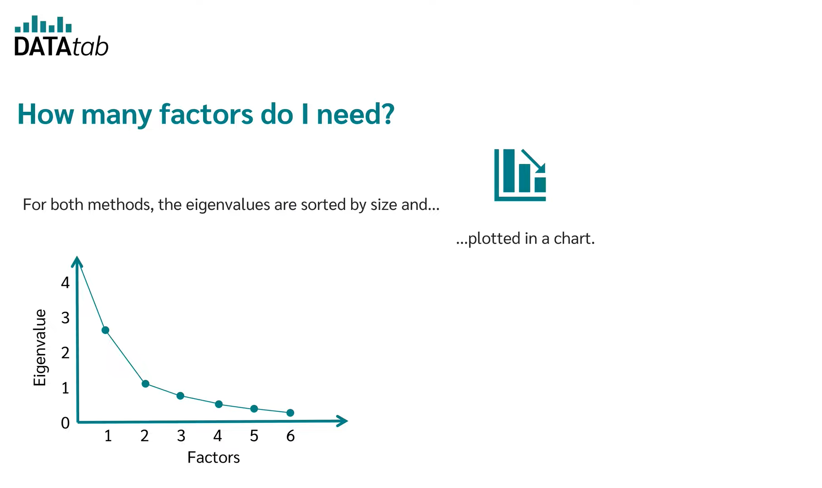

Slide 10
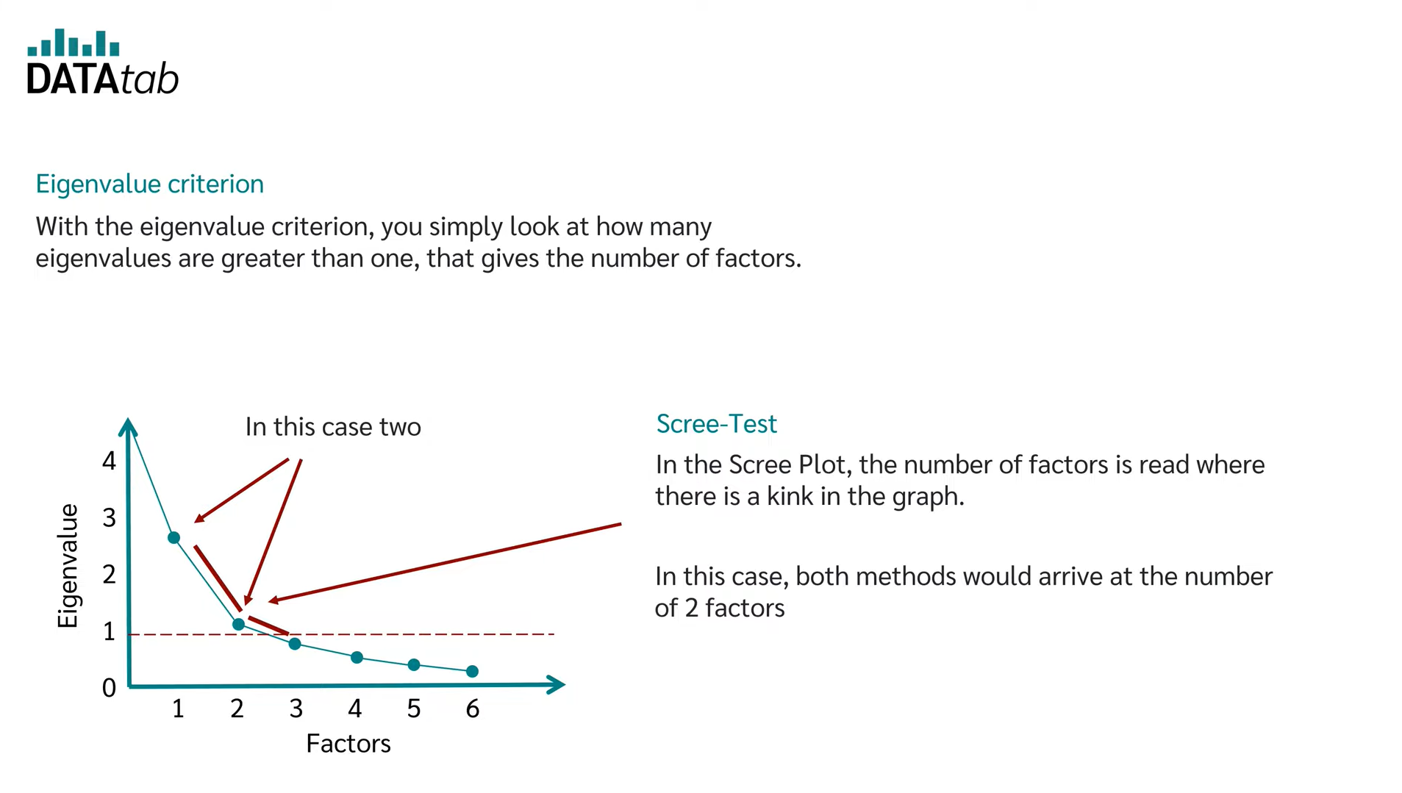

Slide 11
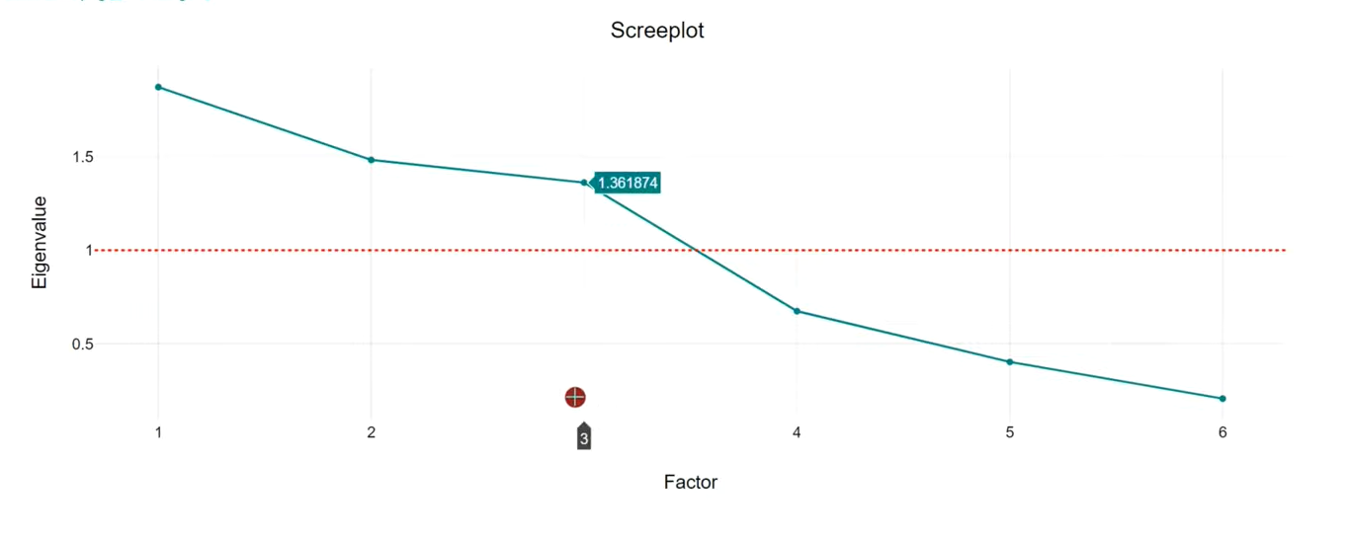
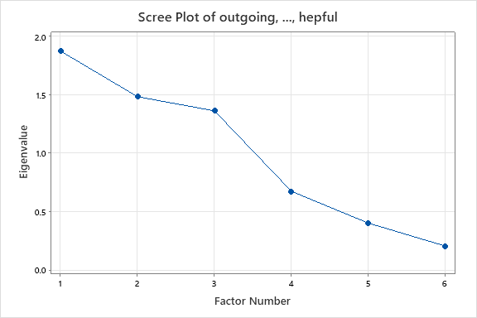
Minitab Output

Slide 12


Slide 13
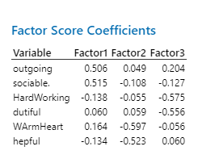
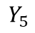
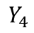
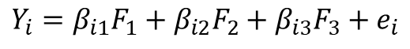
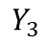
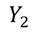
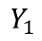
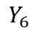
Minitab Output
$$Y_{i}=β_{i1}F_{1}+β_{i2}F_{2}+β_{i3}F_{3}+e_{i}$$
$$Y_{1}=0.506F_{1}+0.049F_{2}+0.204F_{3}$$
$$Y_{1}$$
$$Y_{2}=0.515F_{1}−0.108F_{2}−0.127F_{3}$$
$$Y_{2}$$
$$Y_{3}=−0.138F_{1}−0.055F_{2}−575F_{3}$$
$$Y_{3}$$
$$Y_{4}$$
$$Y_{4}=0.060F_{1}+0.059F_{2}−0.556F_{3}$$
$$Y_{5}$$
$$Y_{6}$$
$$Y_{5}=0.164F_{1}−0.597F_{2}−0.056F_{3}$$
$$Y_{6}=−0.134F_{1}−0.523F_{2}+0.060F_{3}$$

Slide 14
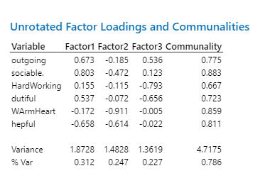
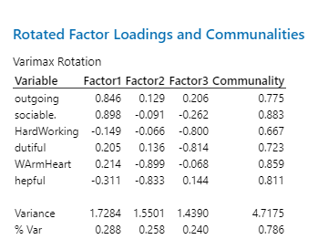
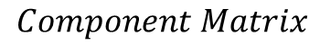
Minitab Output
$$Component Matrix$$

Slide 15
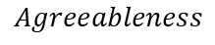
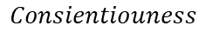
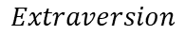
$$Consientiouness$$
Minitab Output
$$Extraversion$$
$$Agreeableness$$

Slide 16
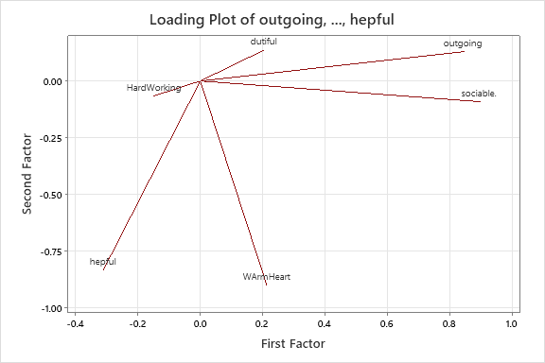
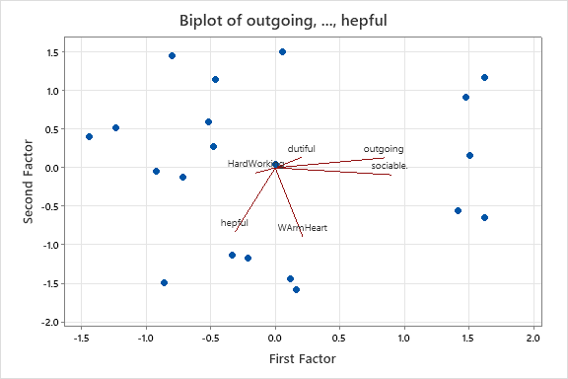
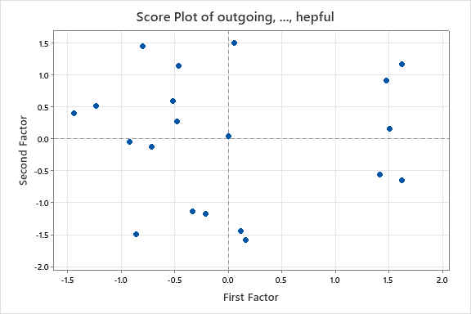
Minitab Output

Slide 17
Ingredientes para el análisis

Slide 18
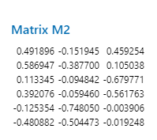
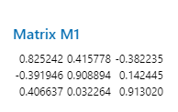


Minitab Output
$$Rotation Matrix$$
$$Eigen Vector Matrix$$

Slide 19
Comandos de MINITAB

Slide 20
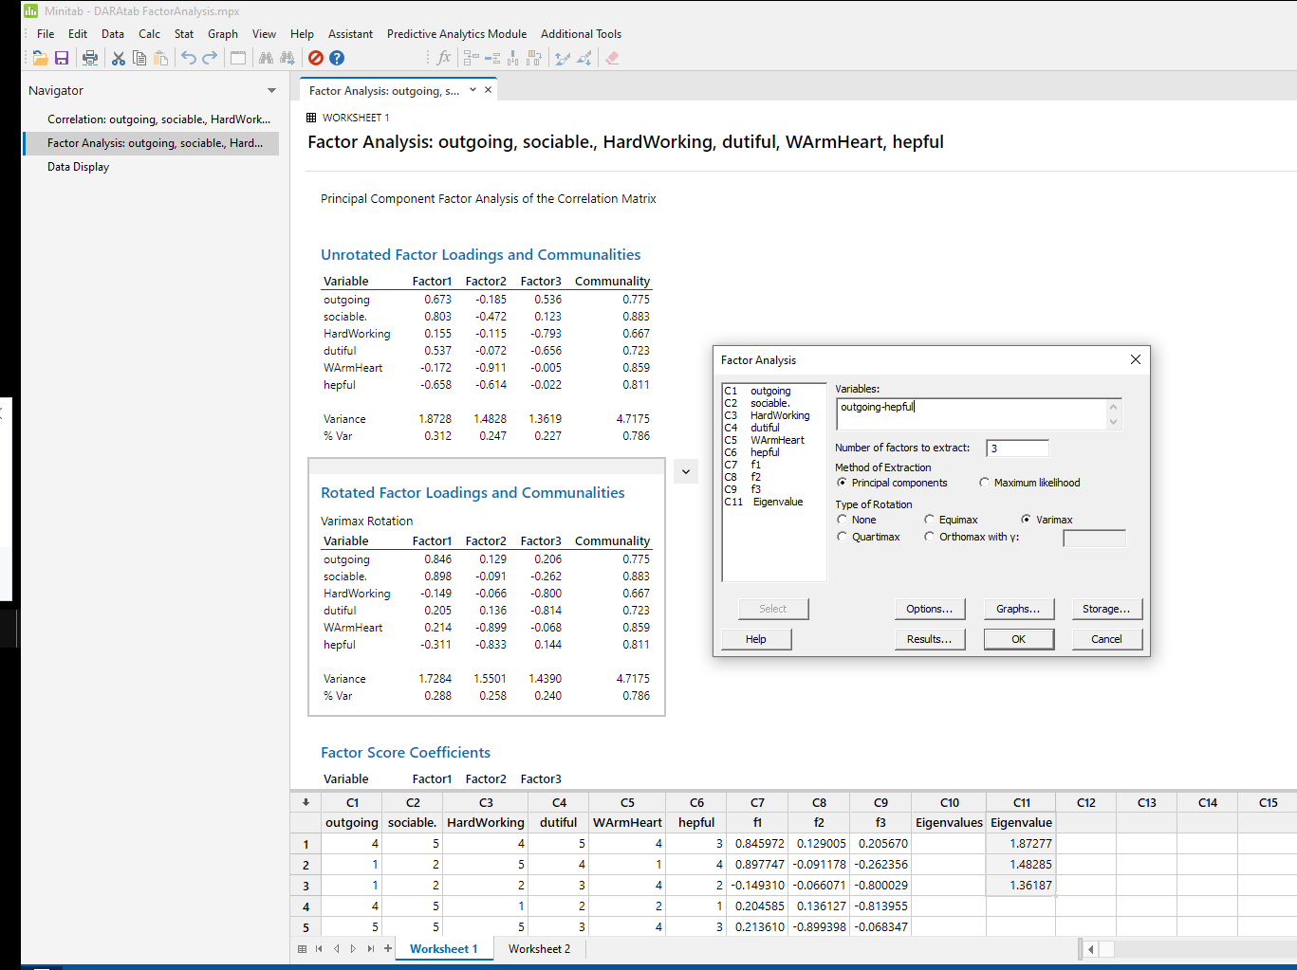

Slide 21
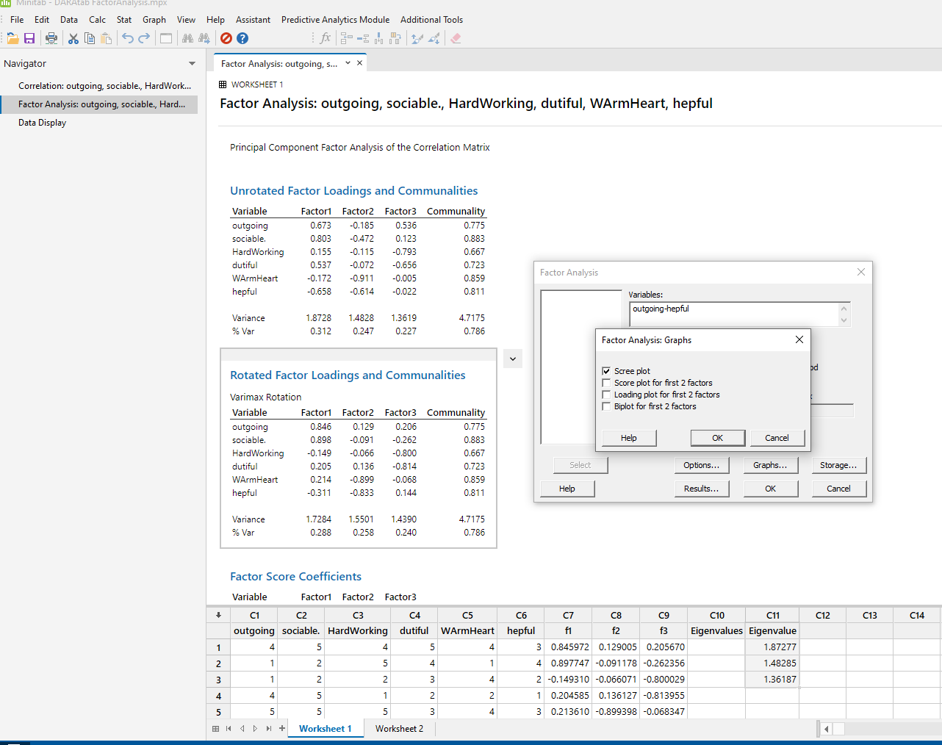

Slide 22


